Slide 1
GROUP 09
AGILE AND SCRUM
HOANG MINH KHANG
NGUYEN HOANG TIN
HUYNH VAN HANH
BUI TRUNG HIEU

Slide 2
01
SOFTWARE DEVELOPMENT METHODOLOGIES

Slide 3
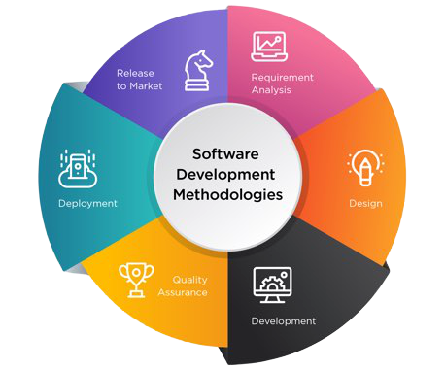
SOFTWARE DEVELOPMENT METHODOLOGIES?
Software development methodology involves diferent provesses for developing the software project and follows a development life cycle.
The methodology is selected based on the aims and objectives of the project.
Software development methodology is an approach in software engineering that provides a framework for defining the structure. Plan, and control different processes while developing an information system.

Slide 4
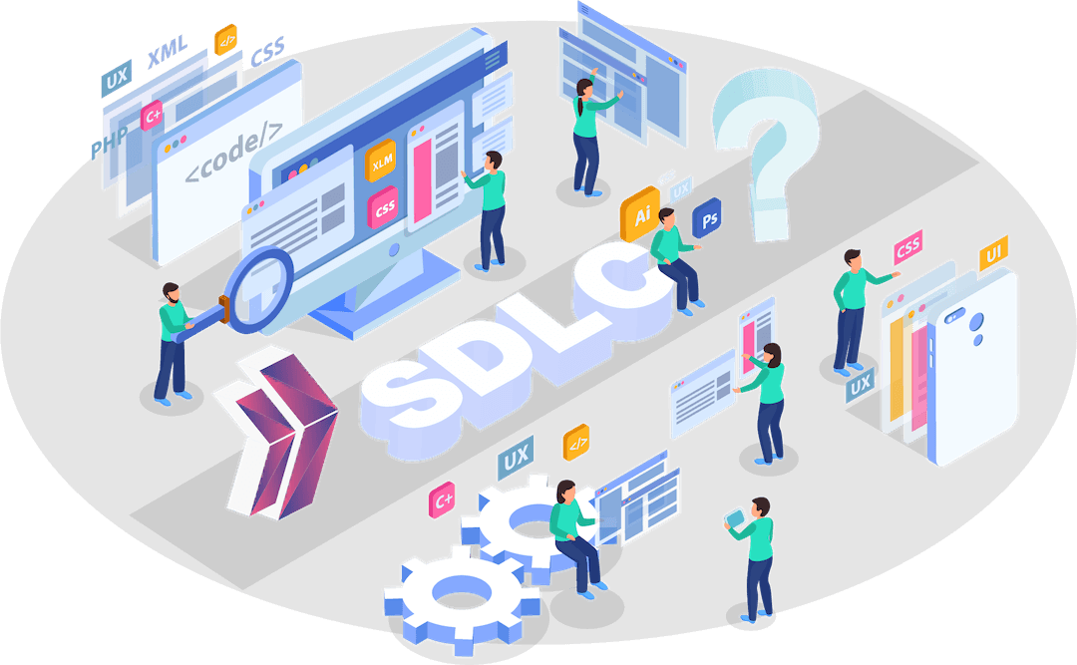
SOFTWARE DEVELOPMENT METHODOLOGIES?
Software system development follows a life cycle approach called the Systems Development Life Cycle(SDLC) and companies choose this approach in developing their software application/
SDLC is the framework which describes each activity in phases for developing software. There are a series of phases in SDLC.
The Phases in SDLC include:
Requirement gathering
Design
Development
Testing
Implementation
Maintenance

Slide 5
The advantage of choosing SDLC:
Business requirement are gathered in the beginning
Easy to detect error
The processes have definite starting and ending point
Project tracking and control mechanism is available
The project progress is updated with all stakeholders.

Slide 6
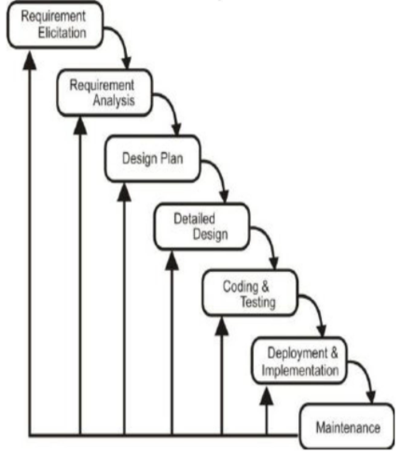
Waterfall development:
The waterfall model is one classical and commonly used model in software development and consists of the following stages:
System requirement documentation
Analyzing requirements
Design of plan
Development or Coding
Testing and Implementation
Actual deployment
Maintenance

Slide 7
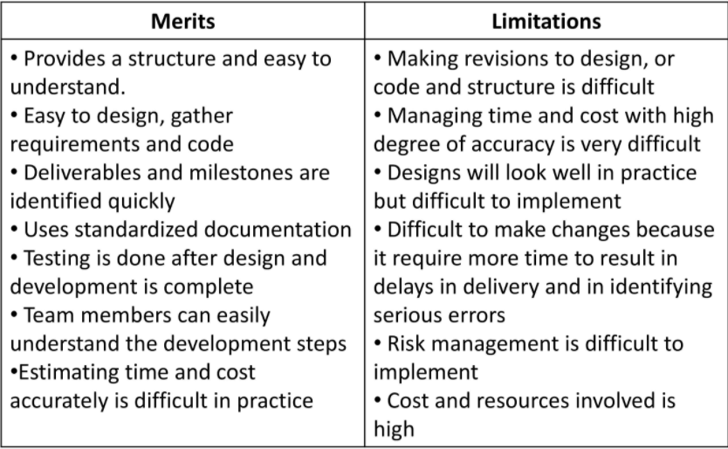
Merits and limitations of waterfall

Slide 8
Waterfall model can be used only when
The software system requirements are clear, known before hand and not subject to change
The system is defined well and technology is understood well
Requirement are consistent without any ambiguity. Planning and estimation is a management activity.
Resources are adequate and expertise is available easily
The project is short and fixed.

Slide 9
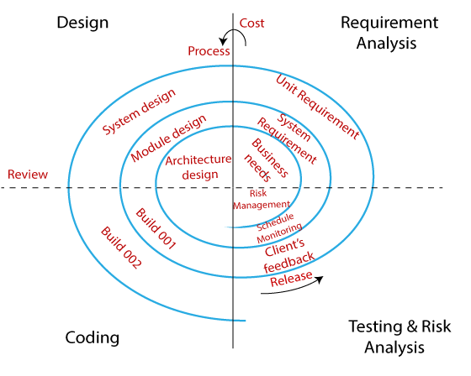
Spiral-model
Spiral-Model is a model that combines waterfall model (Waterfall-Model) and iterative-model (Iterative-Model) and it has many similarities with incremental model ( Incremental-Model).
Focus on project risk analysis. Each phase in the model begins with the design requirement/goal and ends with the customer checking the progress of each phase. The spiral model was first mentioned by Barry Boehm in his 1986 paper.

Slide 10
Stages of the spiral pattern:
Planning phase : Collect and analyze project requirements from customers. Includes the following tasks: estimating costs, scheduling project implementation (schedule-master), determining the number of human resources, identifying necessary resources and work environment, finding out system requirements (requirements) from which to produce specification documents (Business Requirement Specifications and System Requirement specifications) to serve the exchange between customers and system analysis later.
Risk analysis phase : An analytical process will be performed to identify risks and suggest alternatives. A prototype will be created at the end of the risk analysis phase. If any risks are found in this process, alternative solutions will be suggested and implemented.
Engineering phase: This is the stage where the project is code by the developers, the testers test and deploy the software on the customer's website.
Evaluation phase: The customer will participate in this phase to evaluate the work, the product and ensure that the product meets all the requirements set out previously. If there are any change requests from the customer, the stages are repeated. This is an important stage because customer feedback about the product is required before the product is released.

Slide 11
When to use the spiral pattern?
When the project is large-scale.
When the assessment (analysis) of costs and risks is important.
There may be a change request from the customer at any time.
When the project is required to release frequently.
When requirements are unclear and complex.
For medium to high risk projects.
The users are uncertain about their needs.
The software requirements are complex and large.
Need to develop a new product line (New product line).
When there are significant changes (careful research and investigation is required).

Slide 12
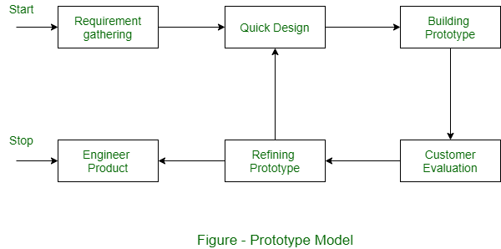
Prototype model
Prototype is a software development model that is developed based on system requirements. Based on the prototype, the customer has an overview of the actual system.
Prototypes are a good idea for large and complex systems that don't have a manual process to help define requirements.
Prototypes are often not the complete system and many details are not built into the prototype. The goal is to provide a system with overall functionality.

Slide 13
Merits and limitations of prototype model
Users who are actively involved in the software development process will gain a better understanding of the system being developed
Bugs can be detected earlier and fixed earlier
Users will easily notice inadequacies and offer solutions to solve them sooner
Avoid system failure
Complicated functions are identified and explained earlier
Authentication is required by the system thereby making the application faster but not fully functional
In fact, the prototype can increase the complexity of the system because the scope of the system can be extended beyond the original plans.
This prototype is evaluated by the customer himself, if the prototype is not satisfied by the customer, it must be redone, wasting time and effort.

Slide 14
When to use the prototype model?
Prototype model should be used when the system needs to have a lot of interaction with the end user
Typically, online systems, web interfaces with a very high amount of interaction with end users, are best suited to the Prototype model.
The prototype should ensure that the end user continuously interacts with the system and provides feedback that needs improvement on the prototype to create a usable system.

Slide 15
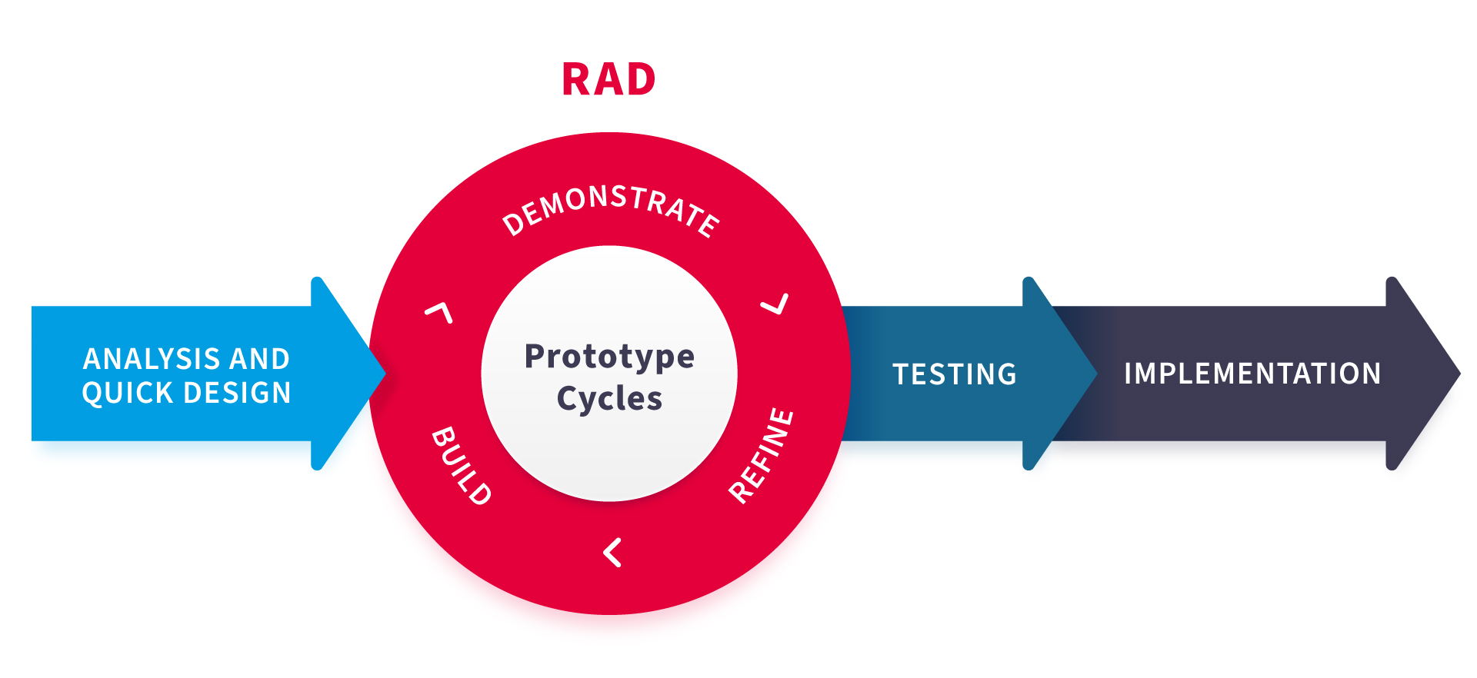
Rapid Application Development (RAD):
- Is an effective methodology that provides much quicker development and higher-quality results than those achieved with the other software development methodologies. It is designed in such a way that it easily takes the maximum advantage of the software development
* The main objective of rapid application development methodology is to accelerate the entire software development process
* The goal is easily achievable because it allows active user participation in the development process
Phases in Rad

Slide 16
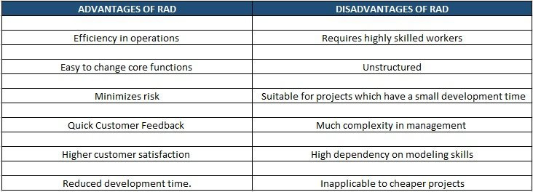
Merits and limitations of RAD:

Slide 17
When to use the RAD?
The common reason is the project have to meet a tight deadline.
Reliably test the prototypes, a pool of users who can give consistent and reliable feedback on the prototypes => Easily change or fix in developing process.
Compared to other development models, rapid application development is relatively inexpensive, but there are some instances where RAD can be expensive. Hiring talented staff means you’ll need to give them appropriate salaries

Slide 18
02
Agile methodology

Slide 19
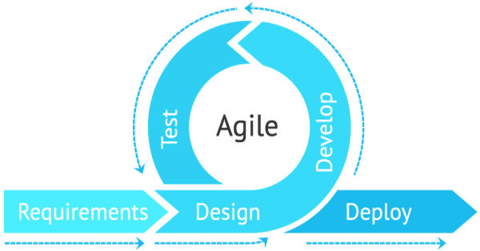
Agile methodology
Agile Software Development is a general term that refers to all software development techniques and methods that follow the Agile philosophy.
The Agile philosophy is roughly described in the Agile Manifesto (The Manifesto for Agile Software Development) through core values and universal principles, but does not specify the implementation of those values and principles. how. Therefore, Agile methods will make the task more clearly defined so that individuals and groups can easily apply in their work context. These methods all encourage adaptive planning, incremental development, early delivery, and continuous improvement to adapt quickly to change – an inherent weakness of traditional software development methods. system (waterfall).

Slide 20
Benefits of using Agile methodology
1. More Control: Incremental developments hold tremendous value for the project team and the customer. Work can be broken into parts and conducted in rapid, iterative cycles. The regular meetings that are part of agile allow project teams to share progress, discuss problems and work out solutions. They also help make the entire process more transparent.
2. Better Productivity: The incremental nature of the agile method means that projects are completed in shorter sprints, making them more manageable. It also allows products to be rolled out quickly and changes to be easily made at any point during the process.
3. Better Quality: Because it is iterative, one big benefit of agile methodology is the ability to find problems and create solutions quickly and efficiently. The flexibility of the agile method allows project teams to respond to customer reaction and constantly improve the product.
4. Higher Customer Satisfaction: Close collaboration between the project team and the customer provides immediate feedback. The customer is able to make tweaks to their expectations and desires throughout the process. The result: a more satisfied customer.
5. Higher Return on Investment: The agile method’s iterative nature also means the end product is ready for market faster, staying ahead of the competition and quickly reaping benefits. The benefits of the agile method are cutting costs and time to market in half, while increasing application quality and customer satisfaction.

Slide 21
12 Principles Behind the Agile Manifesto
Satisfy Customers Through Early & Continuous Delivery
Our highest priority is to satisfy our customers
Welcome Changing Requirements Even Late in the Project
Changing requests should be most welcome even at the late stages of project execution
Deliver Value Frequently
Break the Silos of Your Project
Regularly deliver well-run software to customers, from weeks to months, preferring shorter timeframes
Entrepreneur and developer must work together daily throughout the project
Build Projects Around Motivated Individuals
The Most Effective Way of Communication is Face-to-face
Reducing micromanagement and empowering motivated team members, projects will be completed faster and with better quality
By communicating in person, you reduce the time between asking a question and receiving an answer

Slide 22
12 Principles Behind the Agile Manifesto
Working Software is the Primary Measure of Progress
If the result of your work is not the way your customer expects it to be, you are in trouble
Maintain a Sustainable Working Pace
Agile processes promote sustainable development. Sponsors, developers, and users can maintain an unlimited continuum.
Continuous Excellence Enhances Agility
Simplicity is Essential
Continued interest in good engineering and design for increased flexibility.
Simplicity – the art of maximizing unfinished business – is fundamental
Self-organizing Teams Generate Most Value
Regularly Reflect and Adjust Your Way of Work to Boost Effectiveness
The best architectures, best requirements and best designs will be made by self-organizing teams.
It is related to evaluating your performance and identifying room for improvement

Slide 23
03
Scrum Framework

Slide 24
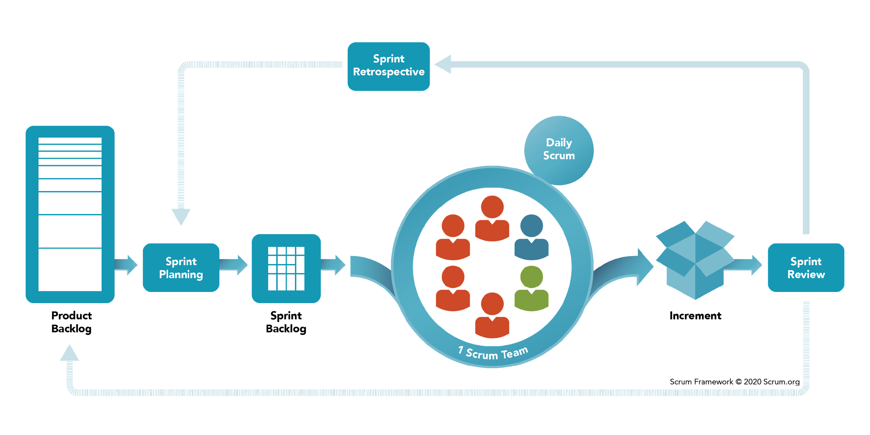
What is scrum?
Scrum is an agile development methodology used in the development of Software based on an iterative and incremental processes. Scrum is adaptable, fast, flexible and effective agile framework that is designed to deliver value to the customer throughout the development of the project. The primary objective of Scrum is to satisfy the customer’s need through an environment of transparency in communication, collective responsibility and continuous progress. The development starts from a general idea of ​​what needs to be built, elaborating a list of characteristics ordered by priority (product backlog) that the owner of the product wants to obtain.

Slide 25
A brief History on Scrum
The history of Scrum can be traced back to 1986 in the Harvard Business Review (HBR) article titled, “The New Product Development Game” by Hirotaka Takeuchi & Ikujiro Nonaka.
Scrum is a term drawn from Rugby, which refers to how the game is restarted after a foul or when the ball has left the game.
In 1993, Jeff Sutherland and his team at Easel Corporation created the Scrum process to be used in software development processes by combining the concepts of the 1986 article with the concepts of object-oriented development, empirical process control, iterative development and incremental, software processes and productivity improvement, as well as the development of complex and dynamic systems.

Slide 26

Scrum values
These values include:
Courage
Focus
Commitment
Respect
Openness

Slide 27
Scrum values
Courage
Scrum values the courage of each individual contributor to the team. While we may not always think of courage in the context of an office job, there are certain circumstances that require some bravery.
“Scrum team members have the courage to do the right thing and work on tough problems.”

Slide 28
Scrum values
Focus
In Scrum, a Sprint is a block of time (no more than four weeks long) in which the team concentrates on a specific set of objectives. On a Scrum Team, focus means that during a Sprint, each individual sets aside pet projects and resists the temptation to work ahead or go back to touch up other tasks.
Every team member must concentrate on the activities included in the Sprint plan in order to support the goals of the team.
““Everyone focuses on the work of the Sprint and the goals of the Scrum Team.”

Slide 29
Scrum values
Commitment
Scrum relies on the personal commitment of each team member to complete the project. It assumes a fairly flat authority structure and does not expect managers to convince or coerce team members into completing tasks.
Instead, Scrum leads to success on the virtue of each individual’s commitment to the good of the project.
“People personally commit to achieving the goals of the Scrum Team.”

Slide 30
Scrum values
Respect
Scrum generally consists of collaborative and self-organizing teams, but each member is independent in the sense that no one is constantly checking his or her work. It is assumed that each individual is capable of doing her job without constant oversight or “checking in” by a manager or coworker.
This also means encouraging and expecting people to ask for help when they need it, trusting that every team member will be ready to help since each is committed to the project’s success.
“Scrum Team members respect each other to be capable, independent people.”

Slide 31
Scrum values
Openness
Nearly every project comes with challenges. Scrum values openness and honestly communicating to all stakeholders without fear. This means telling a team member honestly if something needs to be re-done and receiving that kind of communication graciously, trusting that everyone is working toward the same goals.
This value of openness also means that project stakeholders are expected to communicate promptly and honestly, if, for example, changes in timeline, resources, or product needs occur.
“The Scrum Team and its stakeholders agree to be open about all the work and the challenges with performing the work.”

Slide 32
Scrum Roles
Scrum Master
Product Owner (PO)
team
01
02
03
The person who leads the team guiding them to comply with the rules and processes of the methodology like the reduction of impediments of the project and works with the Product Owner. The Scrum Master is in charge of keeping Scrum up to date, providing coaching, mentoring and training to the teams in case it needs it.
Product Owner is the representative of the stakeholders and customers who use the software. They focus on the business part and is responsible for the ROI of the project.
A group of professionals with the necessary technical knowledge who develop the project jointly carrying out the stories they commit to at the start of each sprint.

Slide 33
Scrum Events
Sprint
Sprint Planning
Daily Scrum
Sprint Review
Sprint Retrospective

Slide 34
Sprint
Scrum Events
Sprint planning
Sprint planning
Sprint is the basic unit of work for a Scrum team. This is the main feature that marks the difference between Scrum and other models for agile development.
The goal of the Sprint Planning is to define what is going to be done in the Sprint and how it is going to be done. This meeting is held at the beginning of each Sprint and is defined how it will approach the project coming from the Product Backlog stages and deadlines. Each Sprint is composed of different features.
The objective of the Daily Scrum is to evaluate the progress and trend until the end of the Sprint, synchronizing the activities and creating a plan for the next 24 hours. It is a brief meeting that takes place daily during the Sprint period.

Slide 35
Sprint Review
Scrum EVENTs
Sprint Retrospective
The goal of the sprint review is to show what work has been completed with regards to the product backlog for future deliveries. The finished sprint is reviewed, and there should already be a clear and tangible advancement in the product to present to the client.
The team reviews the completed goals of the finished sprint, write down the good and the bad, so as not to repeat the mistakes again. This stage serves to implement improvements from the point of view of the development process. The goal of the sprint retrospective is to identify possible process improvements and generate a plan to implement them in the next Sprint.

Slide 36
Scrum artifacts
Product Backlog (PB)
Increment
The product backlog is a list that collects everything the product needs to satisfy the potential customers. It is prepared by the product owner and the functions are prioritized according to what is more and less important for the business. The goal is for the product owner to answer the question “What should be done”.
The Increment is the sum of all the tasks, use cases, user stories, product backlogs and any element that was developed during the sprint and that will be made available to the end user in the form of Software.

Slide 37
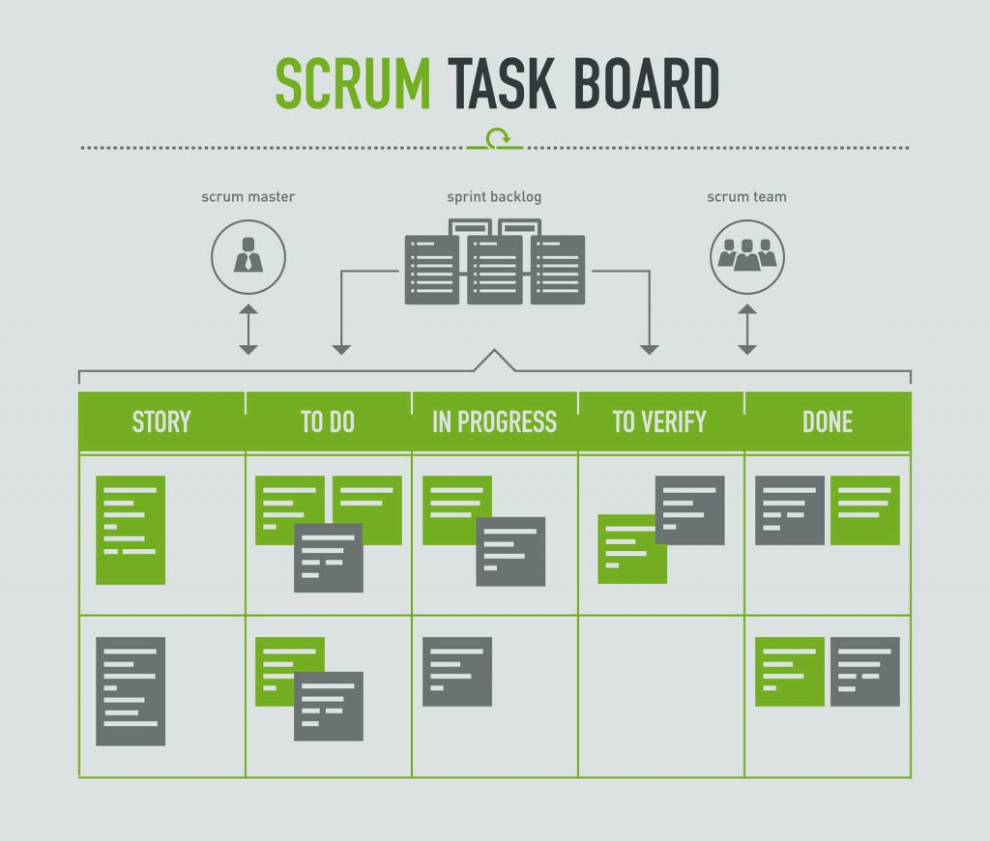
Scrum artifacts
Sprint Backlog (SB)
Sprint Backlog (SB)
It is a subset of items of the product backlog, which are selected by the team to perform during the sprint on which they are going to work. The team establishes the duration of each Sprint. Usually the sprint backlog, is displayed on physical boards called as Scrum board – that makes the development process visible to everyone who enters the development area.

Slide 38
THANKS for Listening!!!

